Slide 1
書法風格的手寫字轉換：一種基於生成對抗 網路的方法 Handwriting to Calligraphy Style Transformation: A Generative Adversarial Network Approach
Department of Computer Science and Information Engineering, Tamkang University
Postgraduate： DAI-HUA, JIANG
Advisor : Dr. MENG-LUEN, WU
Date: 2023/07/06

Slide 2
Outline
INTRODUCTION
RELATED WORKS
PROPOSED METHOD
EXPERIMENTAL RESULTS
CONCLUSIONS

Slide 3
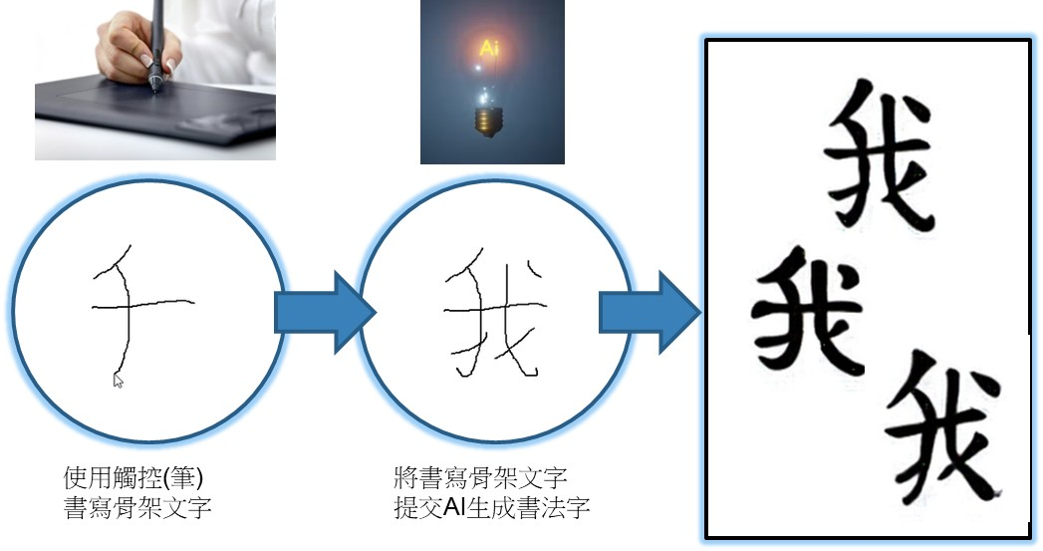
INTRODUCTION
The goal is to input images of handwritten characters written by the user into the GAN and generate calligraphic style characters with the user’s handwriting. In this thesis, we propose a model to implement it.

Slide 4
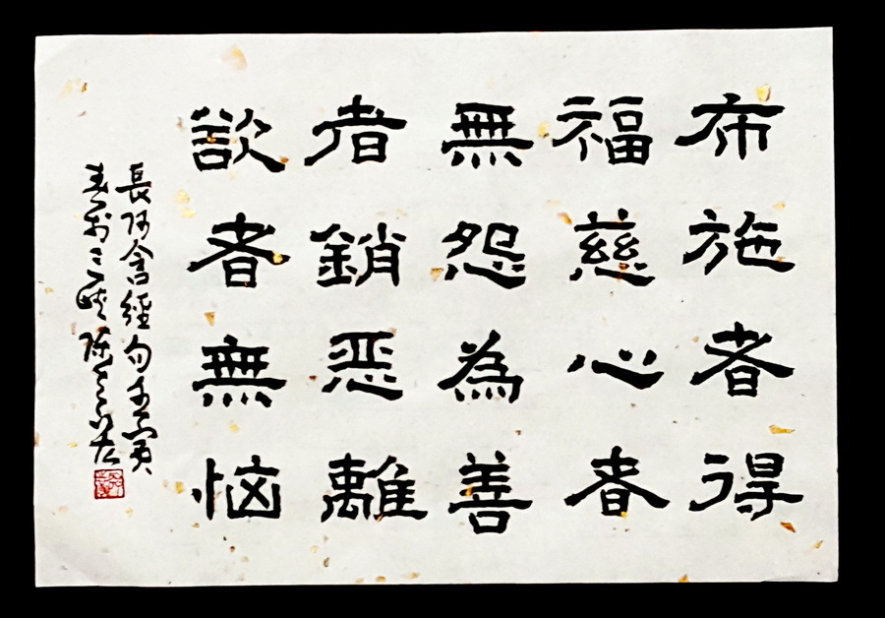
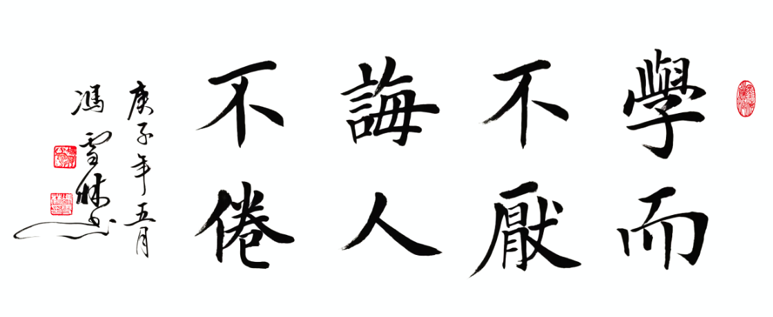
INTRODUCTION
Different font styles of calligraphy exhibit different aesthetic appeal, and even for the same font style, characters written by different calligraphers possess unique charms.
However, calligraphy has been written by fewer and fewer people, promoting calligraphy art is more and more important.

Slide 5


INTRODUCTION
In recent years, there have been some studies that attempt to generate calligraphy fonts by using Generative Adversarial Network (GAN).
These models can transfer fonts into calligraphic styles, allowing the public to enjoy the beauty of calligraphy art.
Generative Adversarial Network
1
2
4
Input
handwriting
Submit
generated
result
Output
Generator
(generate calligraphy)
Discriminator
(Quality control)
Pass
3
Refine and restart
Failed
Repeat

Slide 6
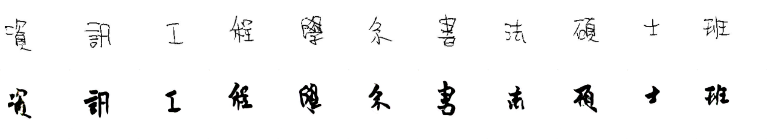
INTRODUCTION
Font generation is a challenging task.
There are thousands Chinese characters.
Different structures and strokes of characters should be considered.
Even for the same style, the same character written by different persons may have varying degrees of stroke deformation.
Moreover, in different styles, the shape of the same stroke may vary.
These issues increase the difficulty of the font generation task.

Slide 7
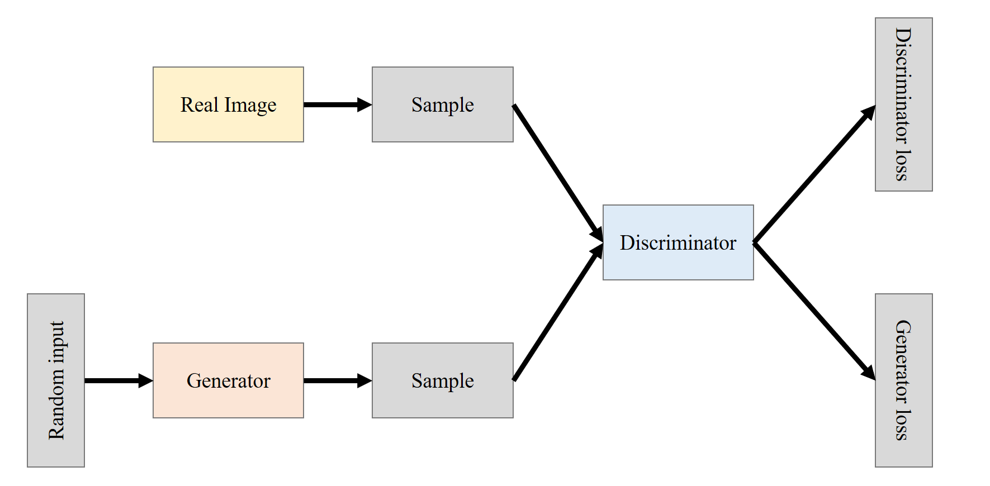
INTRODUCTION
GAN
GAN

Slide 8
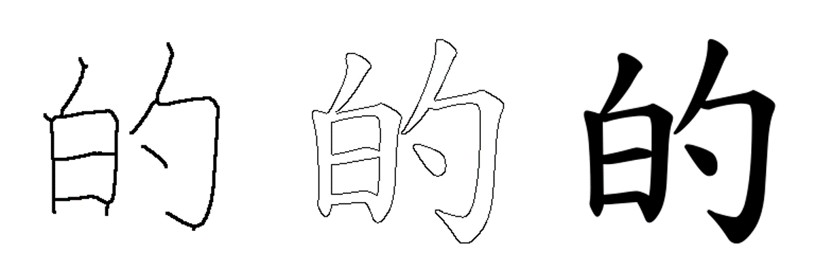
RELATED WORKS
In the early days, calligraphy style font was generated by decomposing strokes and using interpolation to synthesize calligraphy fonts.
Interpolation is a method that uses a known function to calculate the position of a data point in relation to another data point between images.
The font images are processed to extract the character's skeleton, edges, radicals, and strokes.

Slide 9
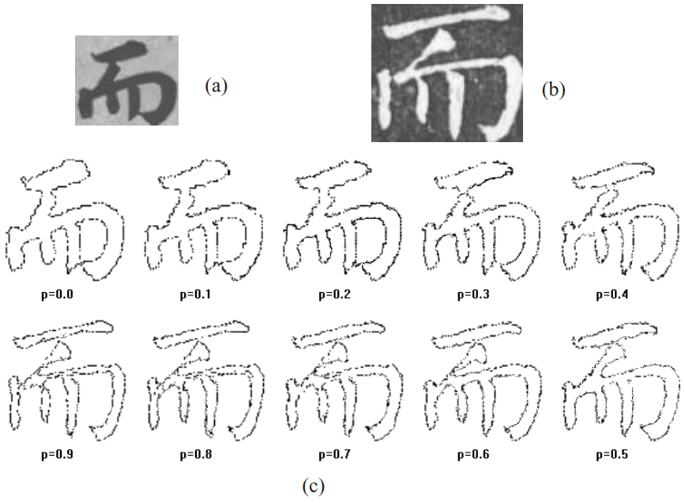
RELATED WORKS
The extract features are used to calculate the displacement of each pixel, resulting in a feature matrix for the character.
Finally, the target calligraphy style is synthesized based on the pixel displacement variations in the character.

Slide 10
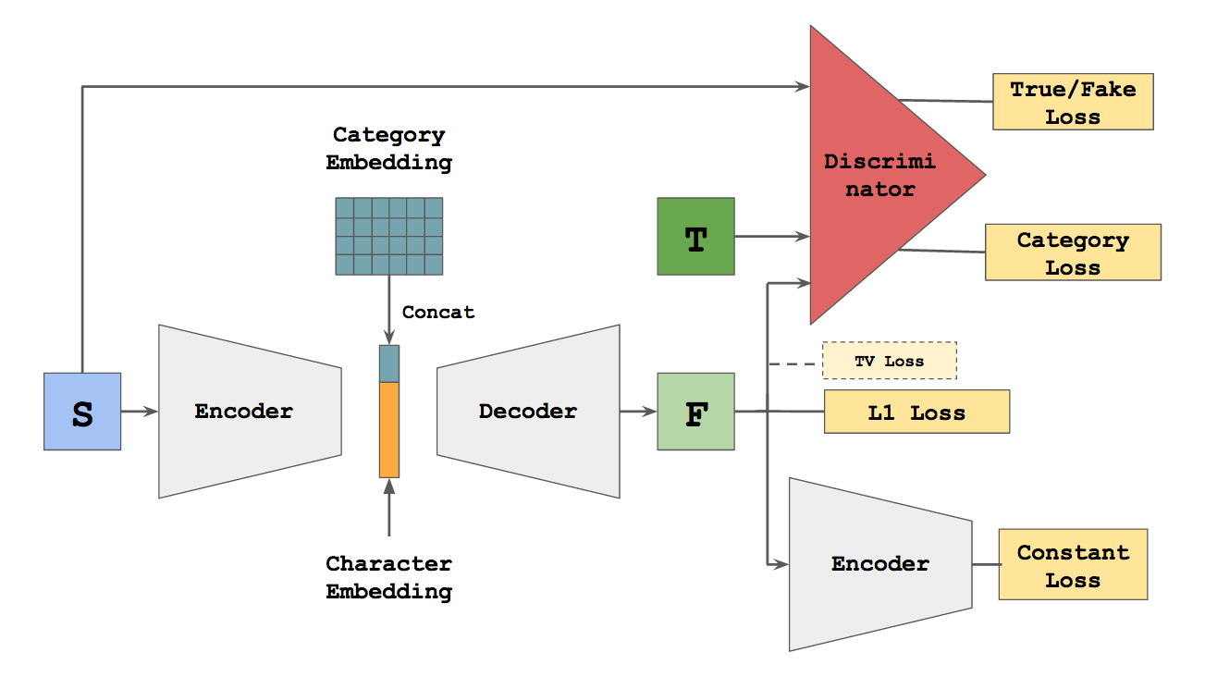
RELATED WORKS
In recent years, GAN-based methods such as zi2zi have been trained in an end-to-end manner to convert input fonts into target font styles and can train multiple styles at once.
However, for characters with more strokes, the generated characters may have missing strokes or blurry regions.
Later, subsequent studies have been conducted to enhance the model’s learning ability.
zi2zi architecture:

Slide 11
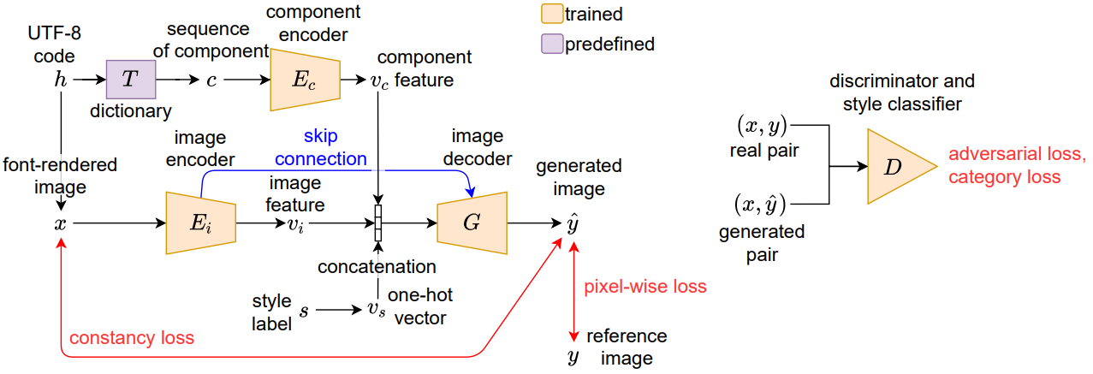
RELATED WORKS
For example, CalliGAN modified based on the zi2zi architecture.
CalliGAN investigated the components that make up each character and encoded them, and then inputted this information into the model, so that the details of the characters generated by the model can perform better.
CalliGAN:

Slide 12
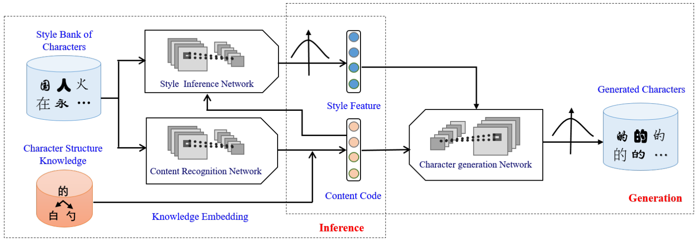
RELATED WORKS
Difference with supervise method. In unsupervised method, the character content and style are regarded as different features and encoded separately.
Taking SA-VAE for example, the content and style features are processed separately in first network, then these two feature are mixed in generation network.
SA-VAE:

Slide 13
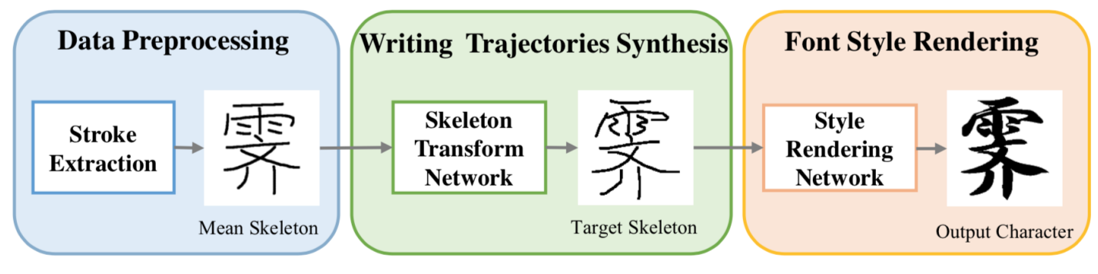
RELATED WORKS
Some studies using algorithms to extract skeleton, components, strokes in images. These features are then used to guide the model to generate fonts.
In SCFont, the architecture is divided into three stages.
SCFont:

Slide 14
RELATED WORKS
In most current methods, they have not enough ability to handle characters which consist of very complex strokes or structure.
Most of methods are focus on Standard Print Font Generation.
We propose a GAN method that can transfer the input character images into target style.
The input font style includes some handwritten characters, and we can transfer to calligraphic styles.

Slide 15
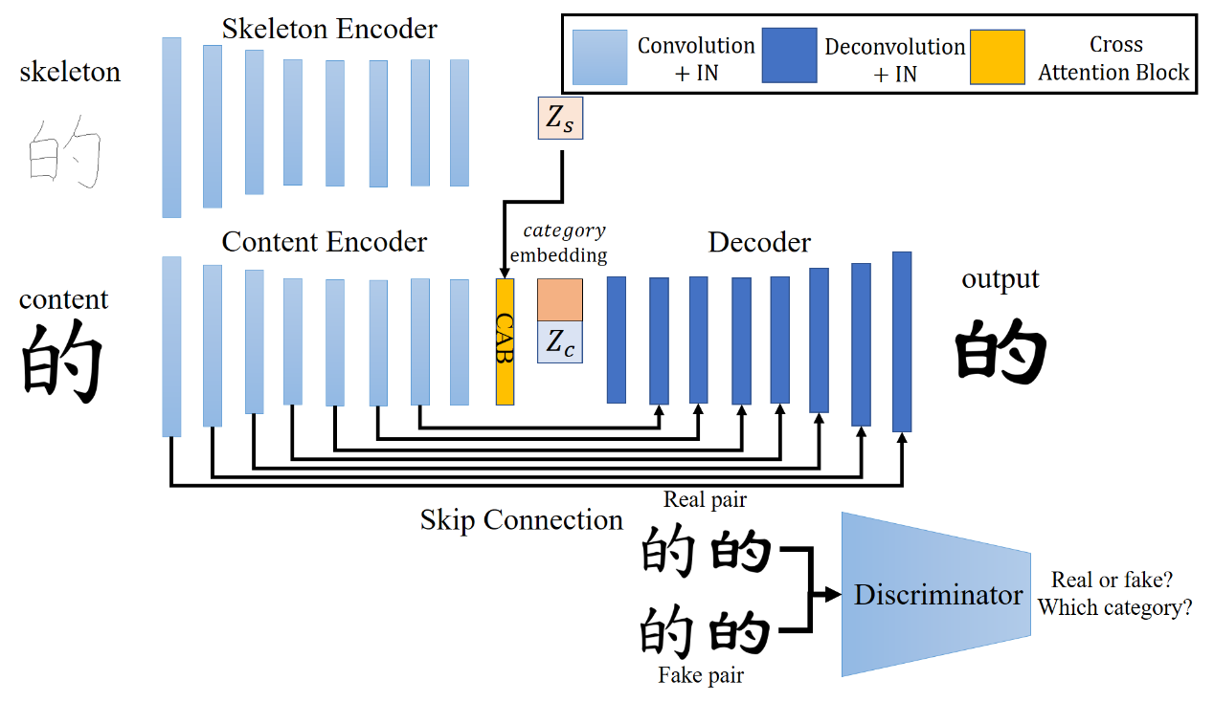
PROPOSED METHOD

Slide 16
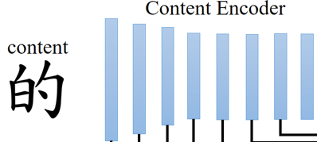
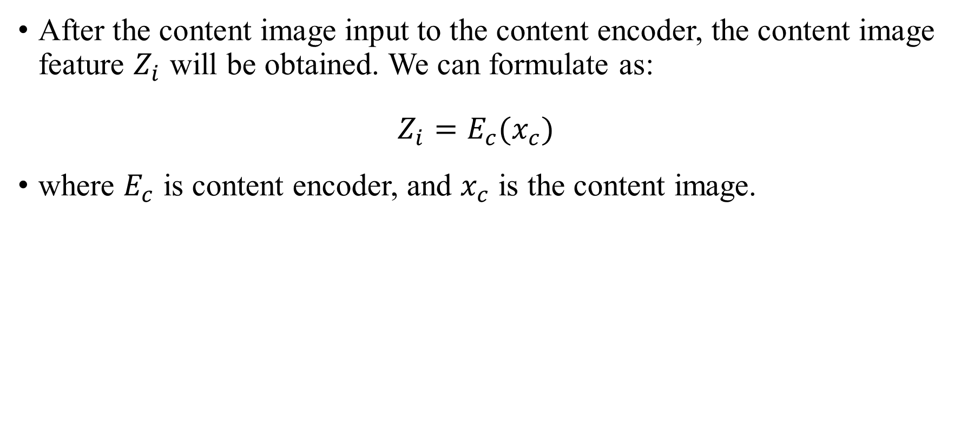
PROPOSED METHOD
After the content image input to the content encoder, the content image feature $Z_{i}$ will be obtained. We can formulate as:
$$Z_{i}=E_{c}(x_{c})$$
where $E_{c}$ is content encoder, and $x_{c}$ is the content image.

Slide 17
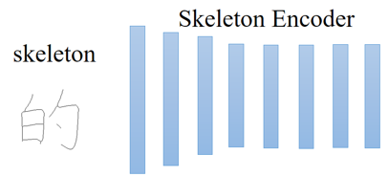
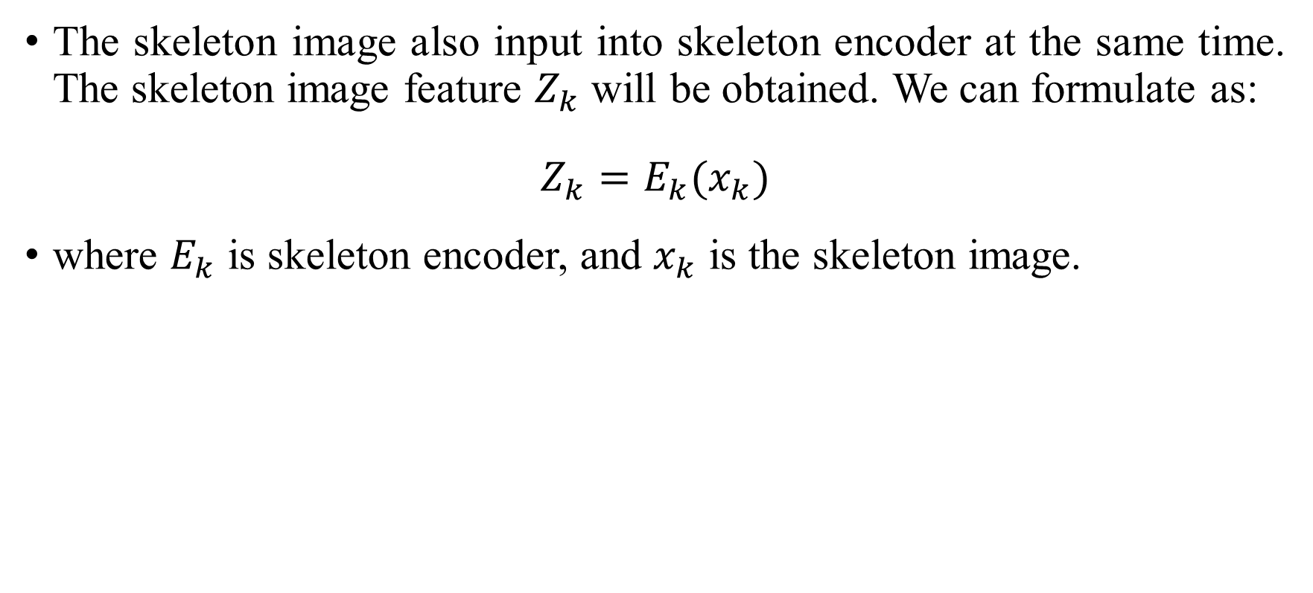
PROPOSED METHOD
The skeleton image also input into skeleton encoder at the same time. The skeleton image feature $Z_{k}$ will be obtained. We can formulate as:
$$Z_{k}=E_{k}(x_{k})$$
where $E_{k}$ is skeleton encoder, and $x_{k}$ is the skeleton image.

Slide 18
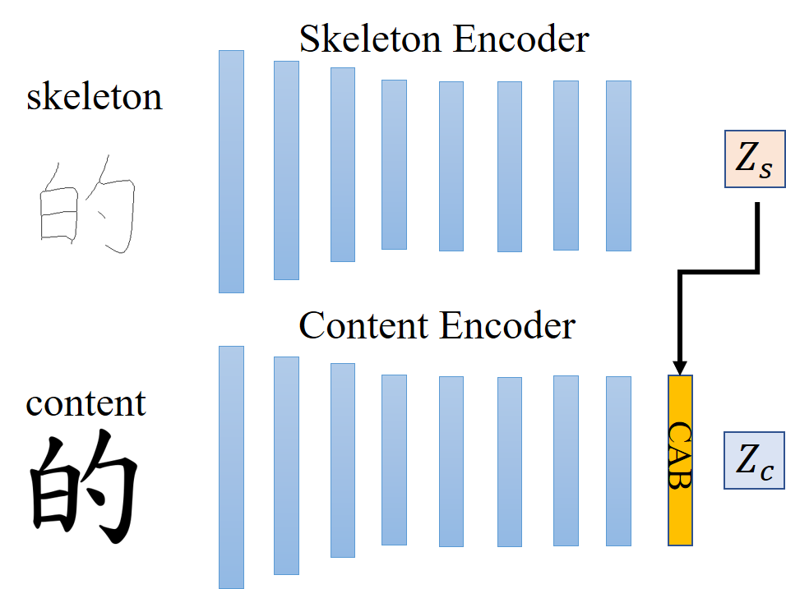
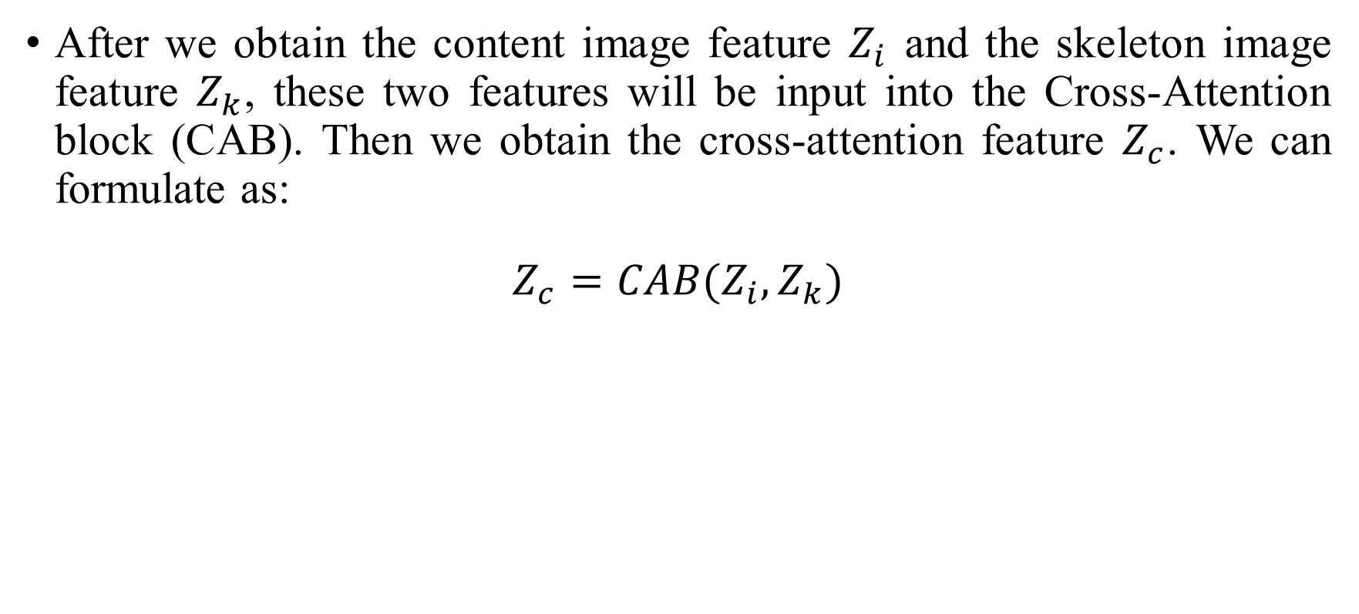
PROPOSED METHOD
After we obtain the content image feature $Z_{i}$ and the skeleton image feature $Z_{k}$, these two features will be input into the Cross-Attention block (CAB). Then we obtain the cross-attention feature $Z_{c}$. We can formulate as:
$$Z_{c}=CAB(Z_{i}, Z_{k})$$

Slide 19
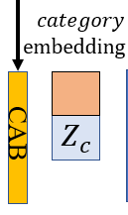
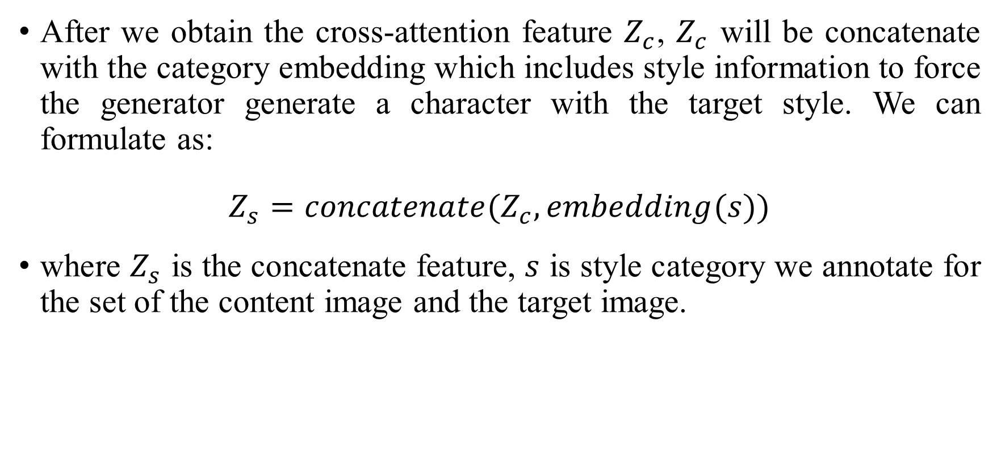
PROPOSED METHOD
After we obtain the cross-attention feature $Z_{c}$, $Z_{c}$ will be concatenate with the category embedding which includes style information to force the generator generate a character with the target style. We can formulate as:
$$Z_{s}=concatenate(Z_{c}, embedding(s))$$
where $Z_{s}$ is the concatenate feature, $s$ is style category we annotate for the set of the content image and the target image.

Slide 20
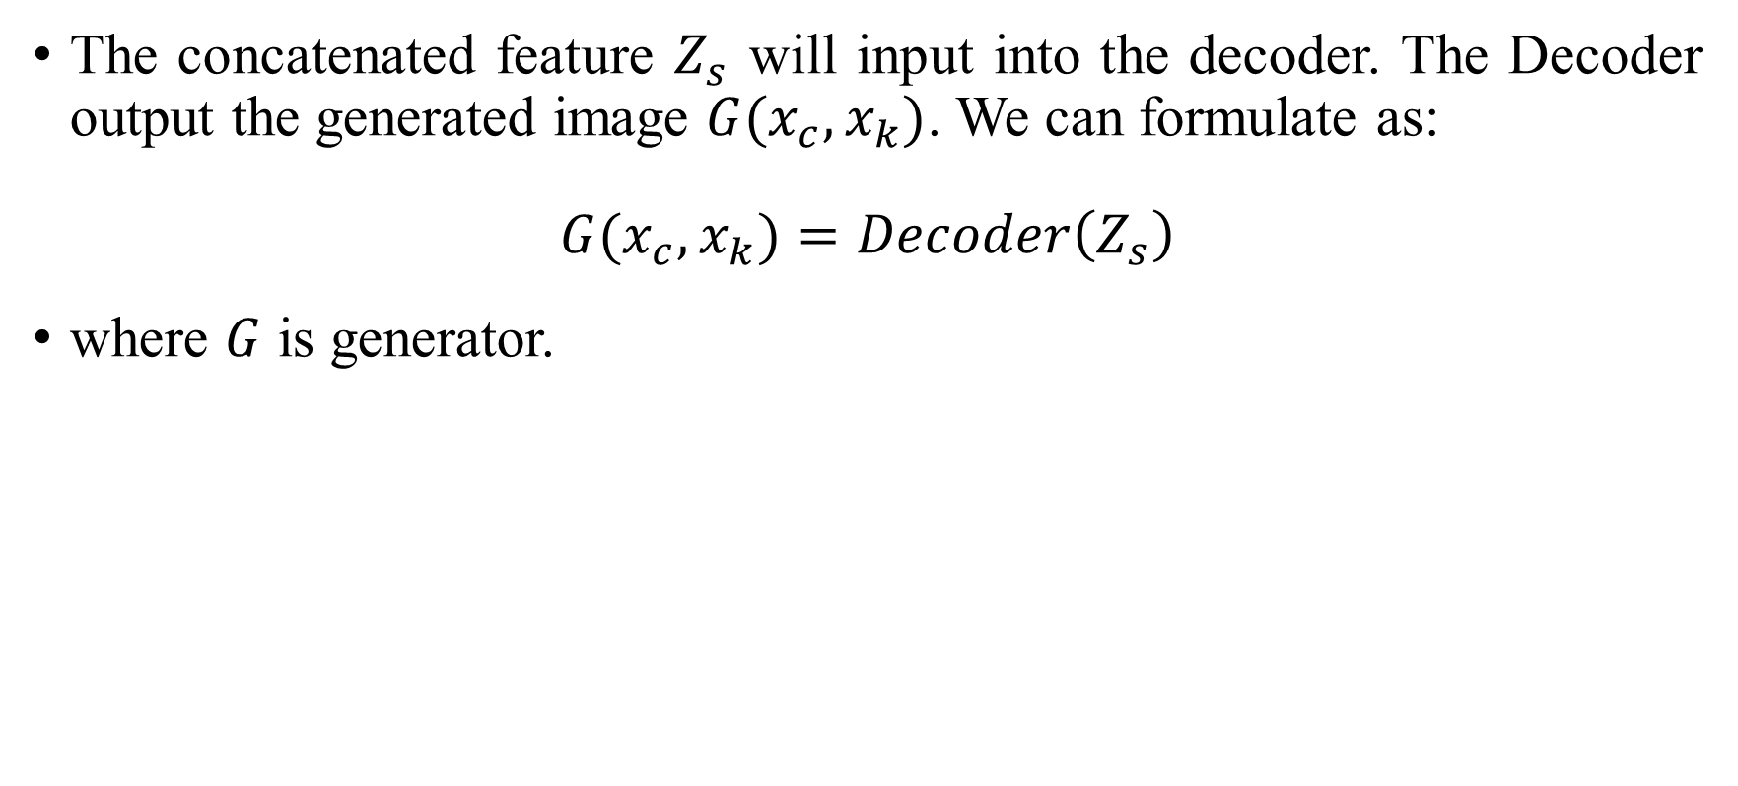
PROPOSED METHOD
The concatenated feature $Z_{s}$ will input into the decoder. The Decoder output the generated image $G(x_{c},x_{k})$. We can formulate as:
$$G(x_{c},x_{k})=Decoder\left(Z_{s}\right)$$
where $G$ is generator.

Slide 21
PROPOSED METHOD
Encoder
Layer | Type | Shape
Input | Image | 256×256×3
L1 | Conv4×4, IN, LeakyReLU | 128×128×64
L2 | Conv4×4, IN, LeakyReLU | 64×64×128
L3 | Conv4×4, IN, LeakyReLU | 32×32×256
L4 | Conv4×4, IN, LeakyReLU | 16×16×512
L5 | Conv4×4, IN, LeakyReLU | 8×8×512
L6 | Conv4×4, IN, LeakyReLU | 4×4×512
L7 | Conv4×4, IN, LeakyReLU | 2×2×512
L8 | Conv4×4, IN, LeakyReLU | 1×1×512

Slide 22
PROPOSED METHOD
Decoder
Layer | Type | Shape
Input | Image | 1×1×(512+128)
L1 | Deconv4×4, IN, ReLU | 2×2×512
L2 | Deconv4×4, IN, ReLU | 4×4×512
L3 | Deconv4×4, IN, ReLU | 8×8×512
L4 | Deconv4×4, IN, ReLU | 16×16×512
L5 | Deconv4×4, IN, ReLU | 32×32×256
L6 | Deconv4×4, IN, ReLU | 64×64×128
L7 | Deconv4×4, IN, ReLU | 128×128×64
L8 | Deconv4×4, IN, Tanh | 256×256×3

Slide 23
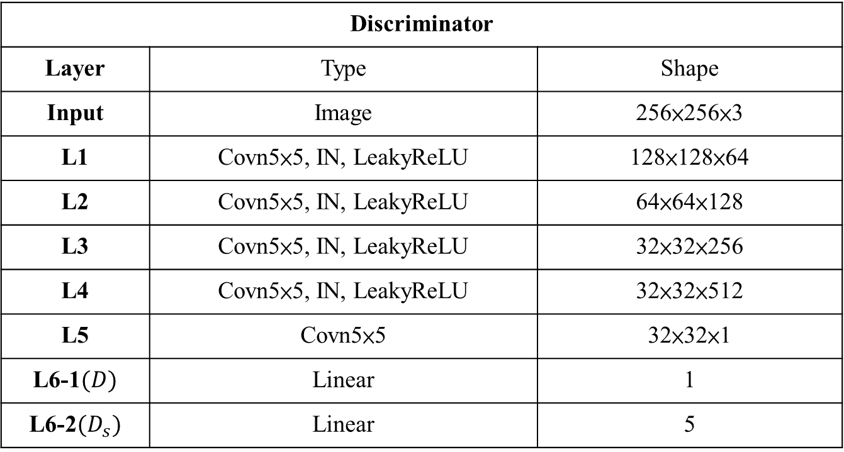
PROPOSED METHOD
Discriminator
Layer | Type | Shape
Input | Image | 256×256×3
L1 | Covn5×5, IN, LeakyReLU | 128×128×64
L2 | Covn5×5, IN, LeakyReLU | 64×64×128
L3 | Covn5×5, IN, LeakyReLU | 32×32×256
L4 | Covn5×5, IN, LeakyReLU | 32×32×512
L5 | Covn5×5 | 32×32×1
L6-1$(D)$ | Linear | 1
L6-2$(D_{s})$ | Linear | 5

Slide 24
PROPOSED METHOD
Normalization is to convert the data into a normal distribution with an average of 0 and a standard deviation of 1, so that the distribution of scattered data is limited to a fixed range.
Batch Normalization (BN)
BN sets a fixed amount of data as a batch and performs normalization for each batch. BN can slow down the gradient descent and internal covariate shift problems that may be encountered when training the model and accelerate the convergence speed of the model. In GAN, the BN layer was originally used to speed up the training of the discriminator, but it was later found to be effective for the generator as well.

Slide 25
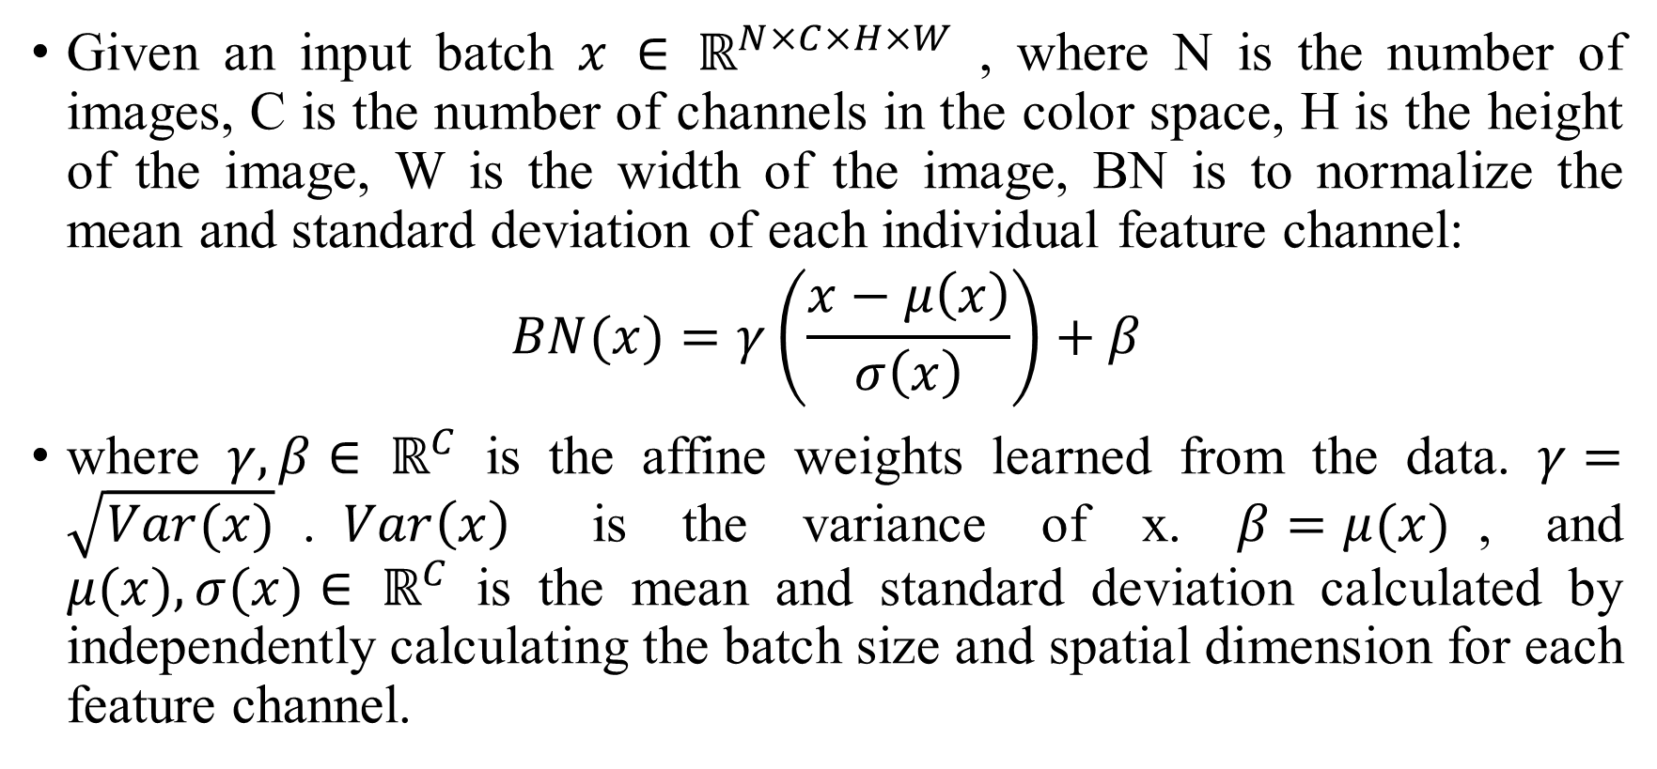
PROPOSED METHOD
Given an input batch $x {∈ ℝ}^{N×C×H×W}$ , where N is the number of images, C is the number of channels in the color space, H is the height of the image, W is the width of the image, BN is to normalize the mean and standard deviation of each individual feature channel:
$$BN(x)=γ\left(\frac{x−μ\left(x\right)}{σ\left(x\right)}\right)+β$$
where $γ, β{∈ ℝ}^{C}$ is the affine weights learned from the data. $γ=\sqrt{Var(x)}$.$Var\left(x\right)$ is the variance of x. $β=μ(x)$, and $μ(x), σ(x){∈ ℝ}^{C}$ is the mean and standard deviation calculated by independently calculating the batch size and spatial dimension for each feature channel.

Slide 26
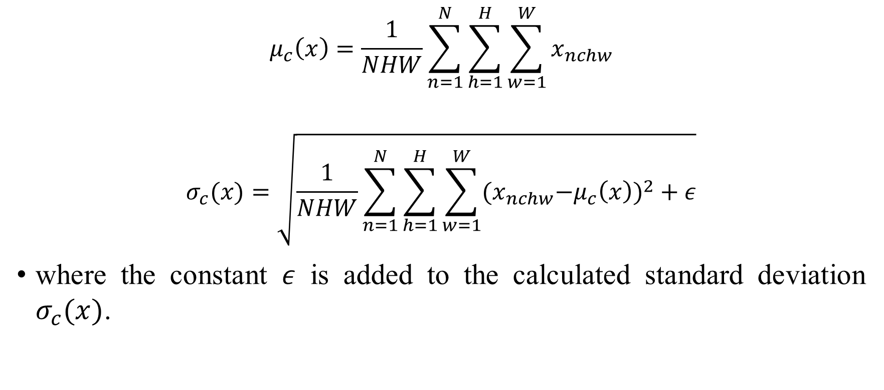
PROPOSED METHOD
$$μ_{c}\left(x\right)=\frac{1}{NHW}\sum_{n=1}^{N}{\sum_{h=1}^{H}{\sum_{w=1}^{W}{x_{nchw}}}}$$
$$σ_{c}(x)=\sqrt{\frac{1}{NHW}\sum_{n=1}^{N}{\sum_{h=1}^{H}{\sum_{w=1}^{W}{{{(x}_{nchw}−μ_{c}\left(x\right))}^{2}}}}+ε}$$
where the constant $ε$ is added to the calculated standard deviation $σ_{c}(x)$.

Slide 27
PROPOSED METHOD
Instance Normalization (IN)
BN uses mini-batch statistics during training and replaces them with new statistics during model inference, which leads to differences between training and inference.
IN performs normalization for each data.
It was found that replacing the BN layer with the IN layer can significantly improve the style transfer network.

Slide 28
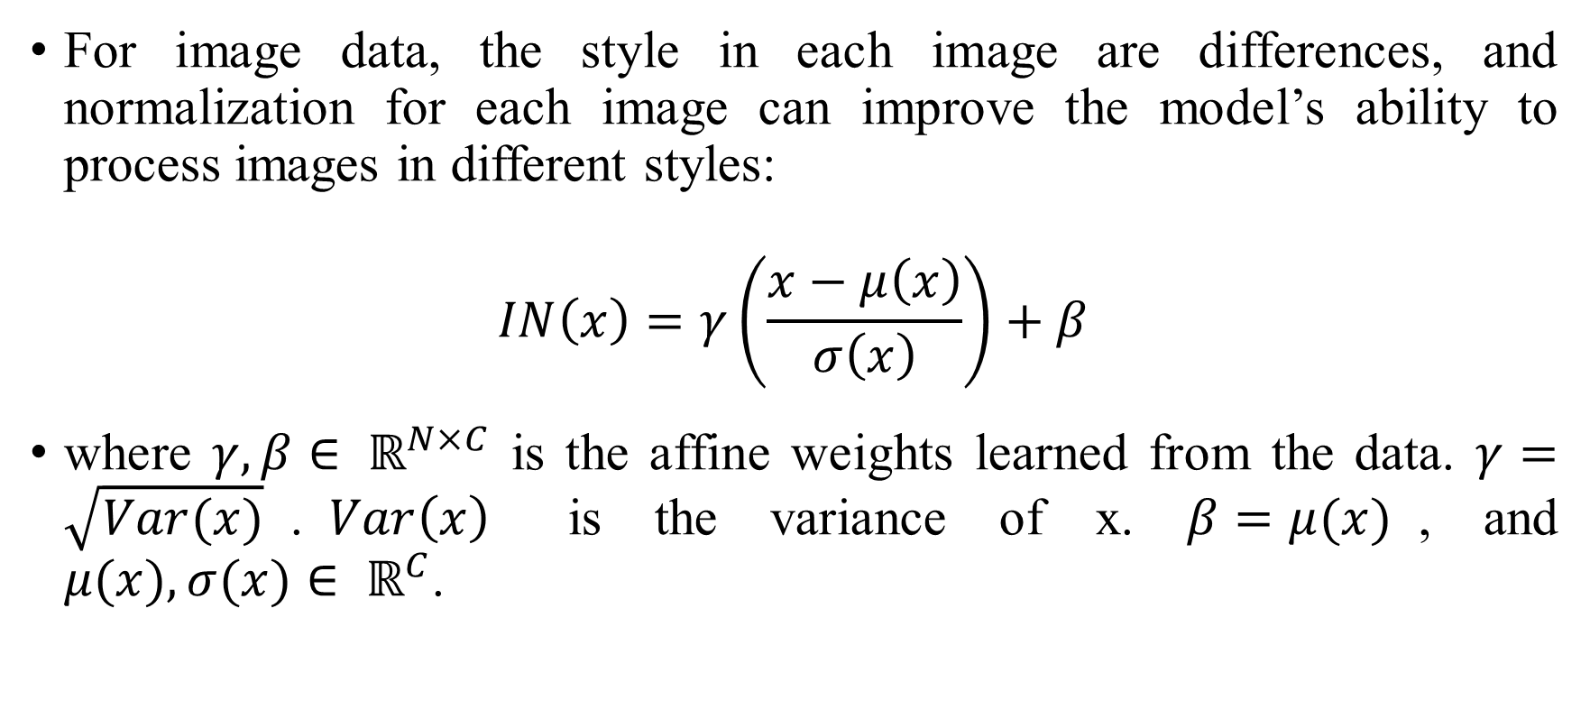
PROPOSED METHOD
For image data, the style in each image are differences, and normalization for each image can improve the model’s ability to process images in different styles:
$$IN\left(x\right)=γ\left(\frac{x−μ\left(x\right)}{σ\left(x\right)}\right)+β$$
where $γ, β{∈ ℝ}^{N×C}$ is the affine weights learned from the data. $γ=\sqrt{Var(x)}$.$Var\left(x\right)$ is the variance of x. $β=μ(x)$, and $μ(x), σ(x){∈ ℝ}^{C}$.

Slide 29
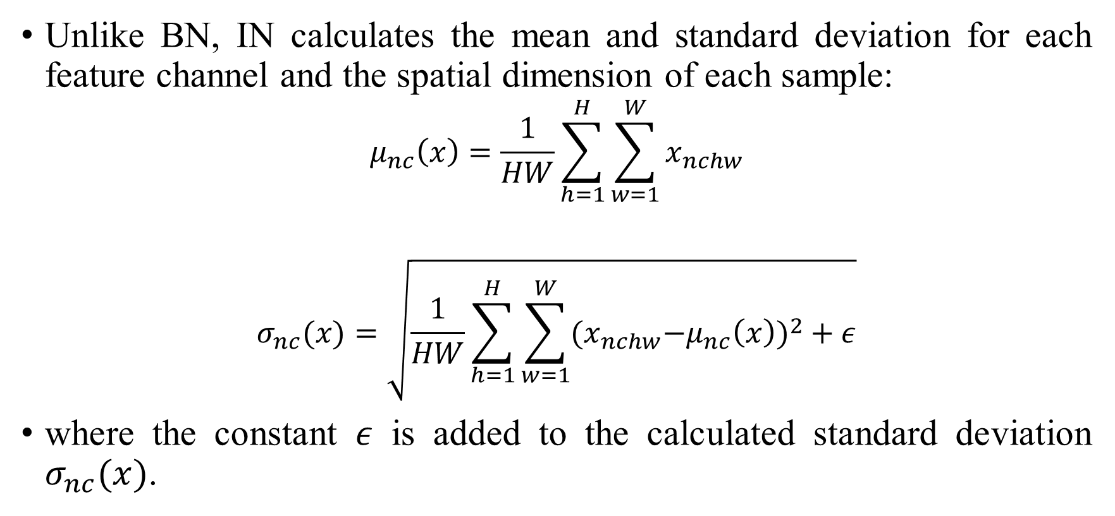
PROPOSED METHOD
Unlike BN, IN calculates the mean and standard deviation for each feature channel and the spatial dimension of each sample:
$$μ_{nc}\left(x\right)=\frac{1}{HW}\sum_{h=1}^{H}{\sum_{w=1}^{W}{x_{nchw}}}$$
$$σ_{nc}(x)=\sqrt{\frac{1}{HW}\sum_{h=1}^{H}{\sum_{w=1}^{W}{{{(x}_{nchw}−μ_{nc}\left(x\right))}^{2}}}+ε}$$
where the constant $ε$ is added to the calculated standard deviation $σ_{nc}(x)$.

Slide 30
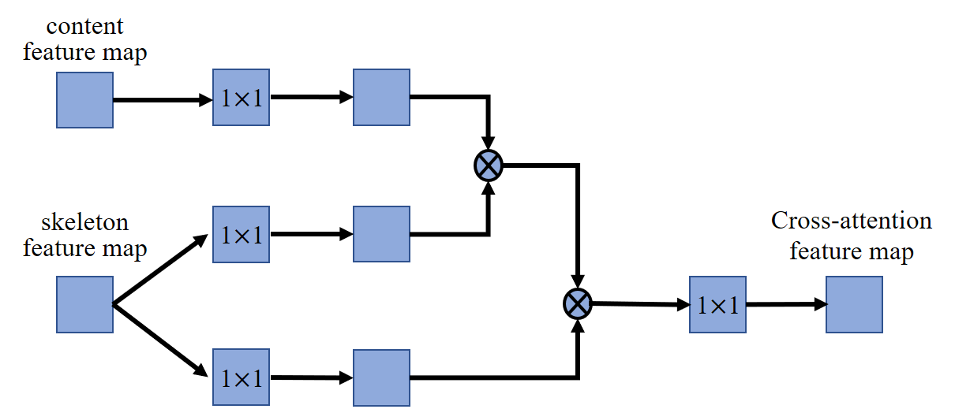
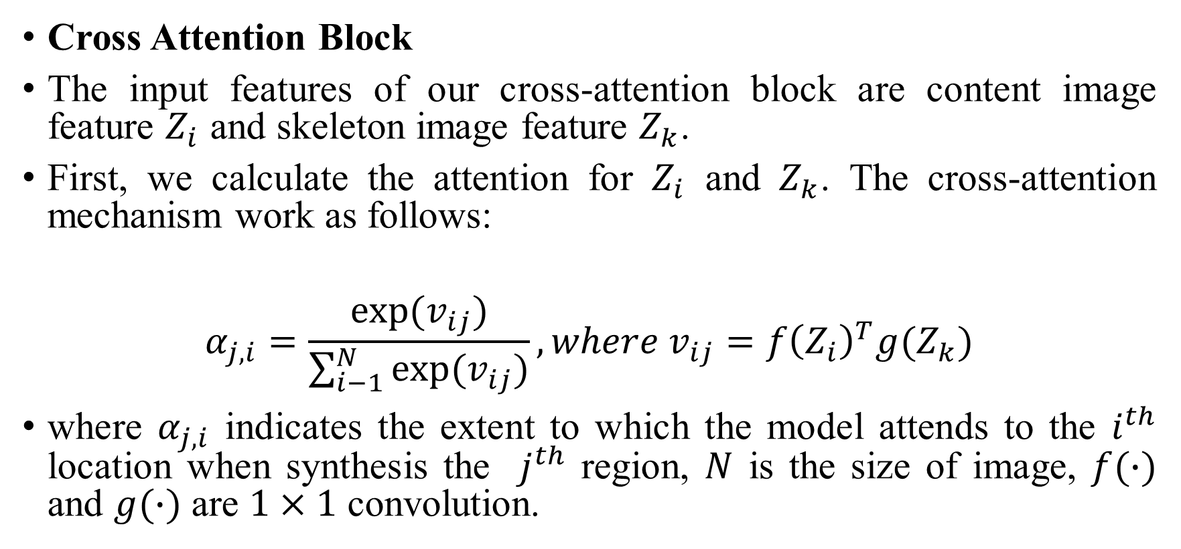
PROPOSED METHOD
Cross Attention Block
The input features of our cross-attention block are content image feature $Z_{i}$ and skeleton image feature $Z_{k}$.
First, we calculate the attention for $Z_{i}$ and $Z_{k}$. The cross-attention mechanism work as follows:
$$α_{j,i}=\frac{exp⁡(v_{ij})}{\sum_{i−1}^{N}{exp⁡(v_{ij})}}, where v_{ij}={f\left(Z_{i}\right)}^{T}g(Z_{k})$$
where $α_{j,i}$ indicates the extent to which the model attends to the $i^{th}$ location when synthesis the $j^{th}$ region, $N$ is the size of image, $f(∙)$ and $g(∙)$ are $1×1$ convolution.

Slide 31
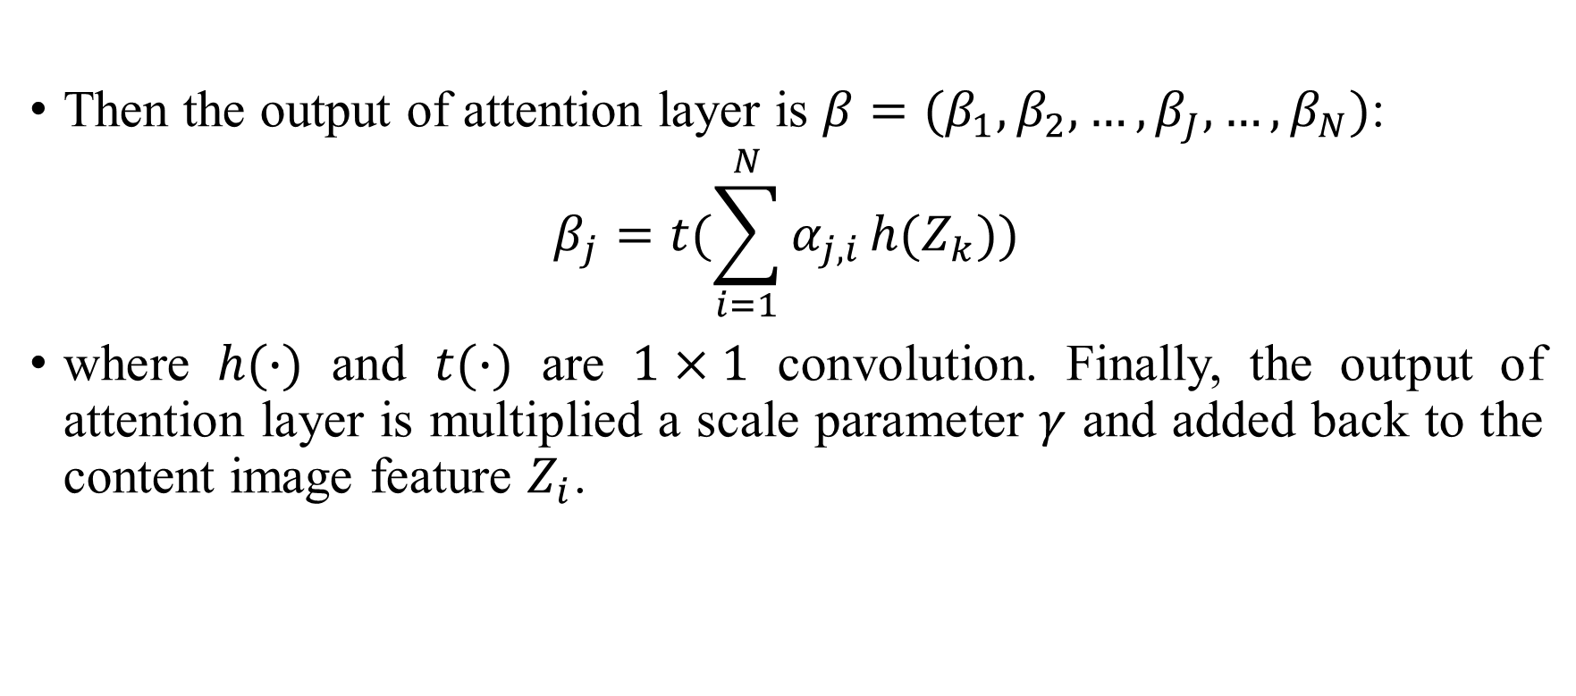
PROPOSED METHOD
Then the output of attention layer is $β={(β}_{1}, β_{2},…,β_{J},…,β_{N})$:
$$β_{j}=t(\sum_{i=1}^{N}{α_{j,i}}h(Z_{k}))$$
where $h(∙)$ and $t(∙)$ are $1×1$ convolution. Finally, the output of attention layer is multiplied a scale parameter $γ$ and added back to the content image feature $Z_{i}$.

Slide 32
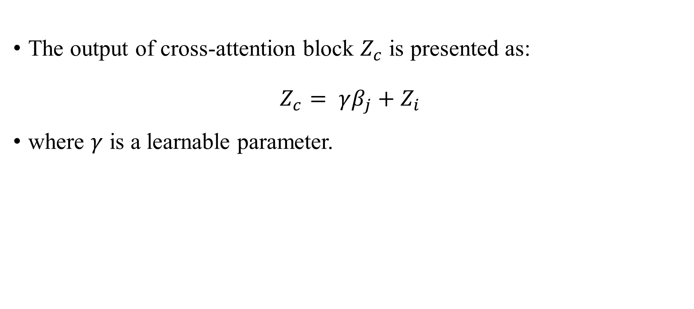
PROPOSED METHOD
The output of cross-attention block $Z_{c}$ is presented as:
$$Z_{c}= γβ_{j}+Z_{i}$$
where $γ$ is a learnable parameter.

Slide 33
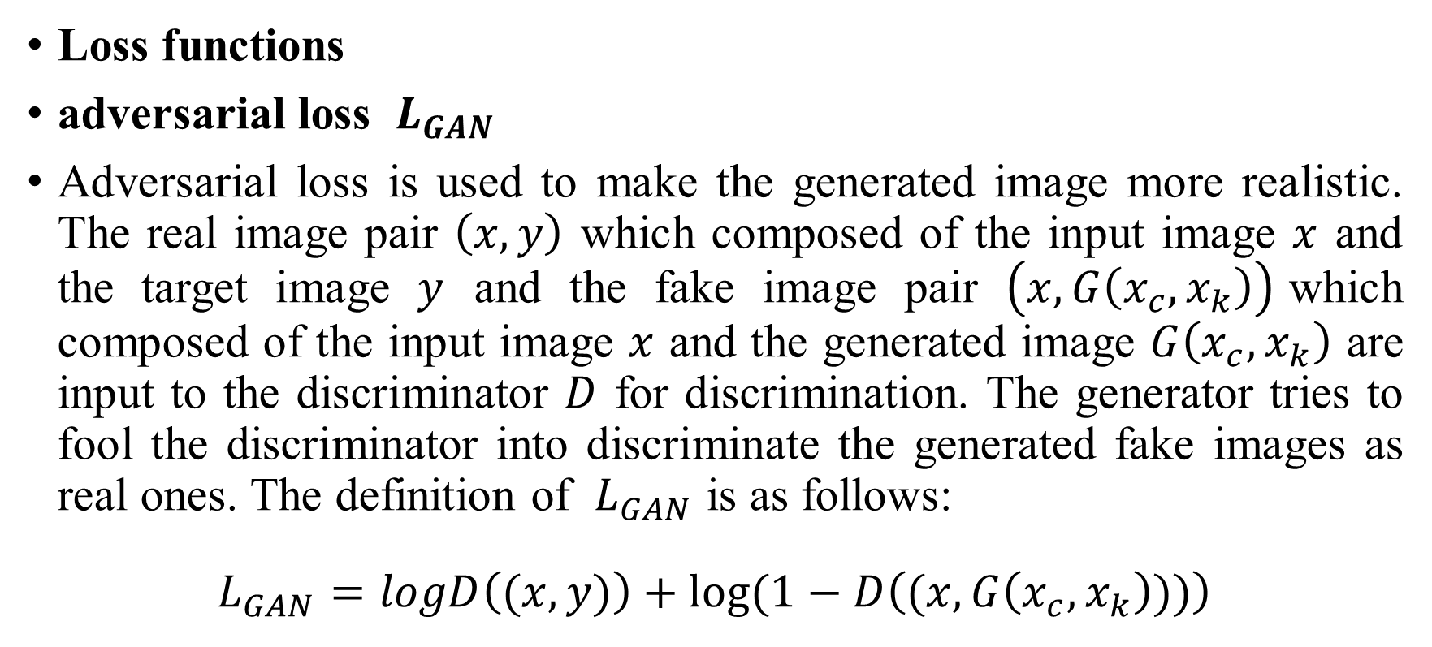
PROPOSED METHOD
Loss functions
adversarial loss $L_{GAN}$
Adversarial loss is used to make the generated image more realistic. The real image pair $\left(x,y\right)$ which composed of the input image $x$ and the target image $y$ and the fake image pair $\left(x,G\left(x_{c},x_{k}\right)\right)$which composed of the input image $x$ and the generated image $G\left(x_{c},x_{k}\right)$ are input to the discriminator $D$ for discrimination. The generator tries to fool the discriminator into discriminate the generated fake images as real ones. The definition of $L_{GAN}$ is as follows:
$$L_{GAN}=logD\left((x,y)\right)+log⁡(1−D\left((x,G\left(x_{c},x_{k}\right)))\right)$$

Slide 34
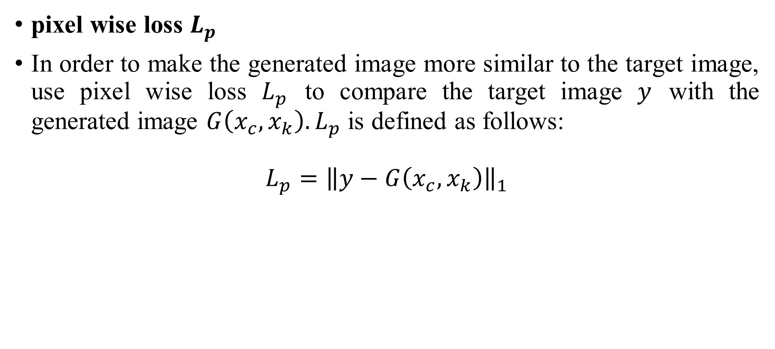
PROPOSED METHOD
pixel wise loss $L_{p}$
In order to make the generated image more similar to the target image, use pixel wise loss $L_{p}$ to compare the target image $y$ with the generated image $G\left(x_{c},x_{k}\right). L_{p}$ is defined as follows:
$$L_{p}={\left\|y−G\left(x_{c},x_{k}\right)\right\|}_{1}$$

Slide 35
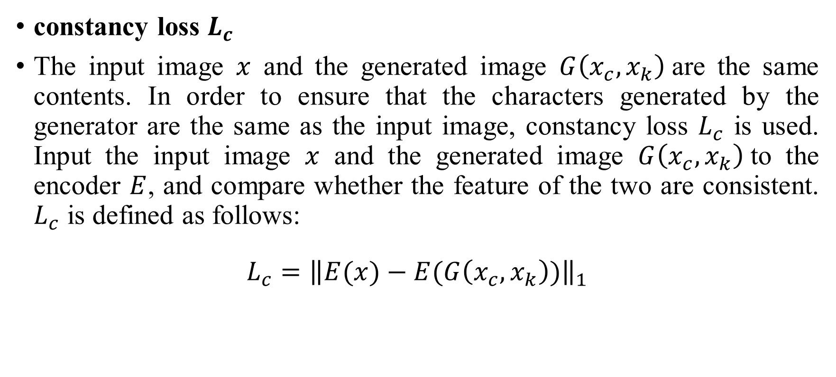
PROPOSED METHOD
constancy loss $L_{c}$
The input image $x$ and the generated image $G\left(x_{c},x_{k}\right)$are the same contents. In order to ensure that the characters generated by the generator are the same as the input image, constancy loss $L_{c}$ is used. Input the input image $x$ and the generated image $G\left(x_{c},x_{k}\right)$to the encoder $E$, and compare whether the feature of the two are consistent. $L_{c}$ is defined as follows:
$$L_{c}={\left\|E(x)−E(G\left(x_{c},x_{k}\right))\right\|}_{1}$$

Slide 36
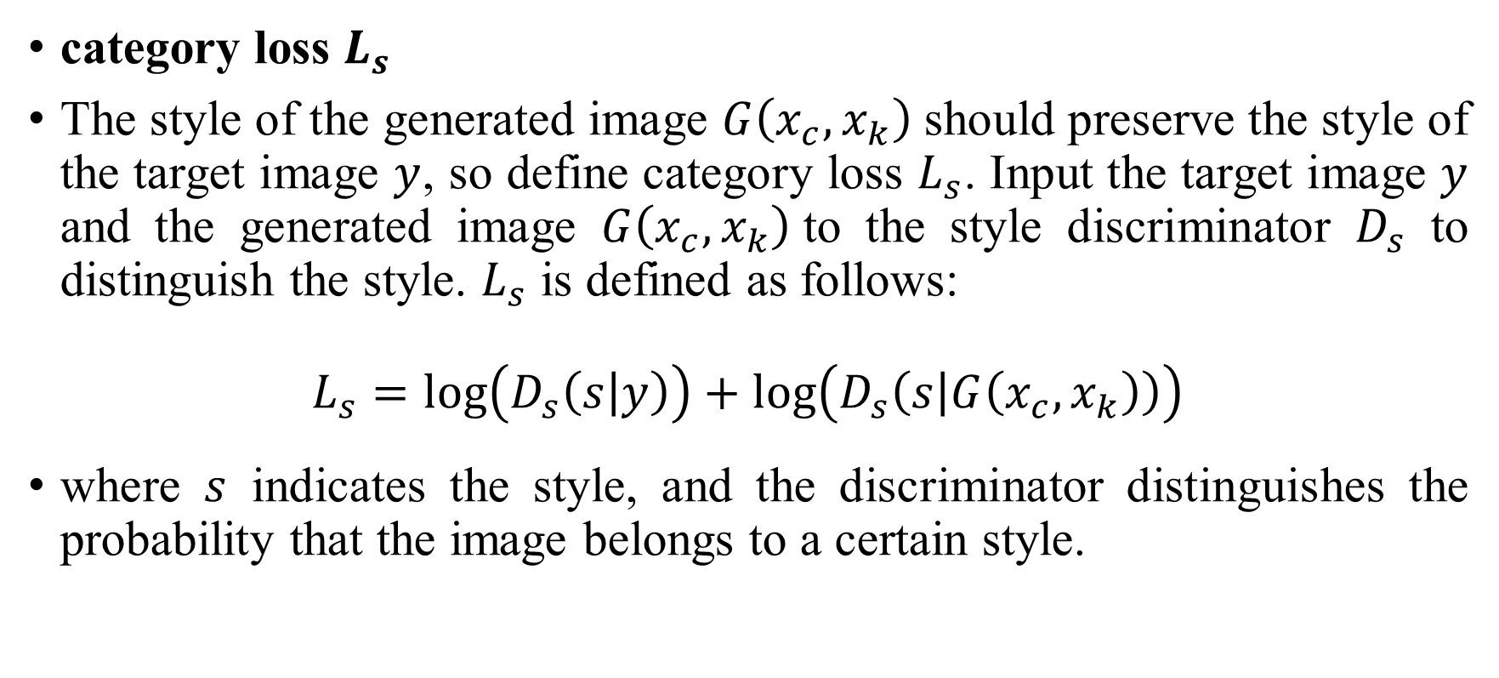
PROPOSED METHOD
category loss $L_{s}$
The style of the generated image $G\left(x_{c},x_{k}\right)$should preserve the style of the target image $y$, so define category loss $L_{s}$. Input the target image $y$ and the generated image $G\left(x_{c},x_{k}\right)$to the style discriminator $D_{s}$ to distinguish the style. $L_{s}$ is defined as follows:
$$L_{s}=\log\left(D_{s}\left(s | y\right)\right)+\log\left(D_{s}\left(s | G\left(x_{c},x_{k}\right)\right)\right)$$
where $s$ indicates the style, and the discriminator distinguishes the probability that the image belongs to a certain style.

Slide 37
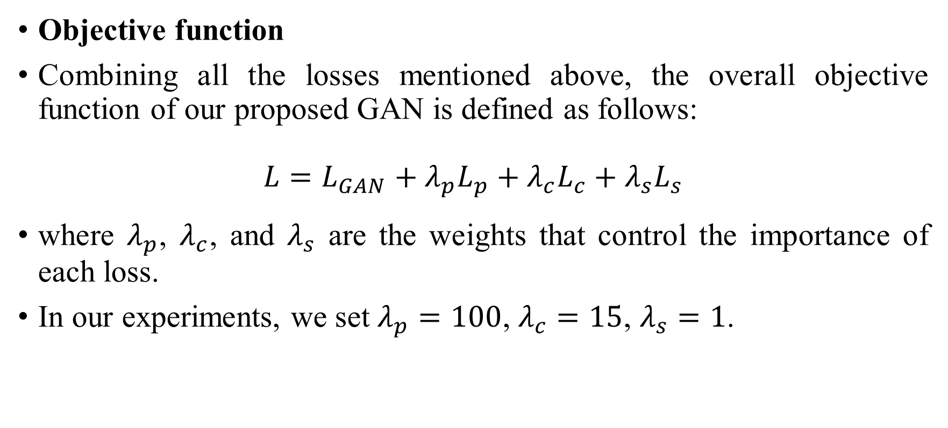
PROPOSED METHOD
Objective function
Combining all the losses mentioned above, the overall objective function of our proposed GAN is defined as follows:
$$L=L_{GAN}+{λ_{p}L}_{p}+{λ_{c}L}_{c}+{λ_{s}L}_{s}$$
where $λ_{p}$, $λ_{c}$, and $λ_{s}$ are the weights that control the importance of each loss.
In our experiments, we set $λ_{p}=100$, $λ_{c}=15$, $λ_{s}=1$.

Slide 38
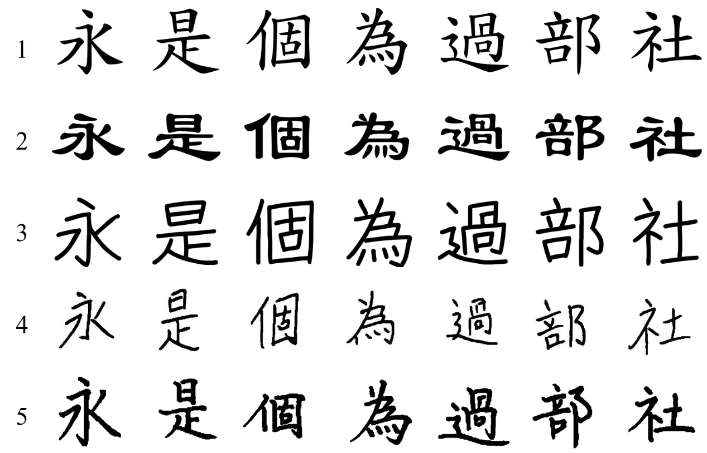
EXPERIMENTAL RESULTS
Dataset: we select 3,000 characters and 5 font styles for our dataset. We use 2,700 characters for training, and 300 characters for test.
We set the batch size as 8, initial learning rate as 0.001 and train for 15 epochs. It takes 20 hours to train our model on a machine equipped with an 8-core 2.5GHz CPU and an 8GB RAM Nvidia GPU RTX 3070.

Slide 39
EXPERIMENTAL RESULTS
Seen style seen font
 | MSE↓ | SSIM↑ | PSNR↑ | LPIPS↓
zi2zi | 7610.72 | 0.706695 | 12.83492 | 0.146119
DGFont | 7589.844 | 0.616528 | 11.57675 | 0.139365
Ours | 6950.919 | 0.716657 | 13.94568 | 0.138525

Slide 40
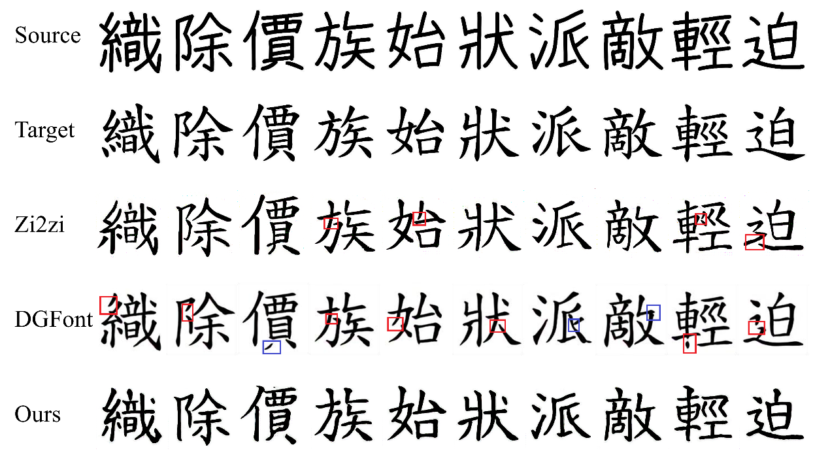
EXPERIMENTAL RESULTS

Slide 41
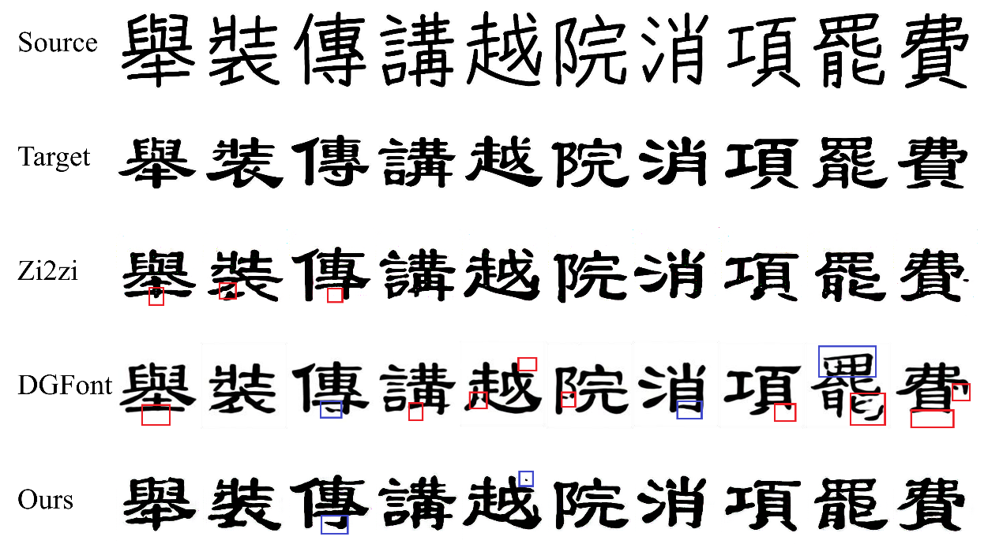
EXPERIMENTAL RESULTS

Slide 42
EXPERIMENTAL RESULTS
Seen style unseen font
 | MSE↓ | SSIM↑ | PSNR↑ | LPIPS↓
zi2zi | 8047.624 | 0.691701 | 12.56907 | 0.1505
DGFont | 7852.578 | 0.600472 | 11.41159 | 0.147485
Ours | 7568.374 | 0.698556 | 13.583 | 0.146196

Slide 43
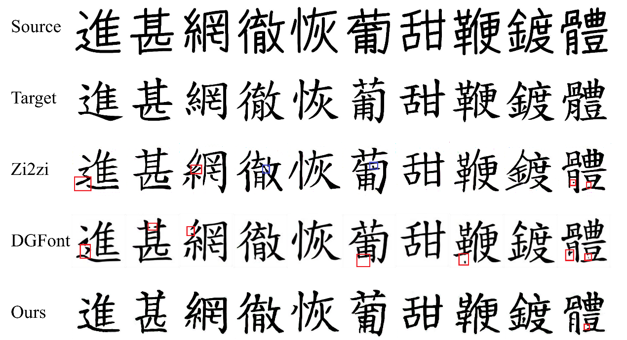
EXPERIMENTAL RESULTS

Slide 44
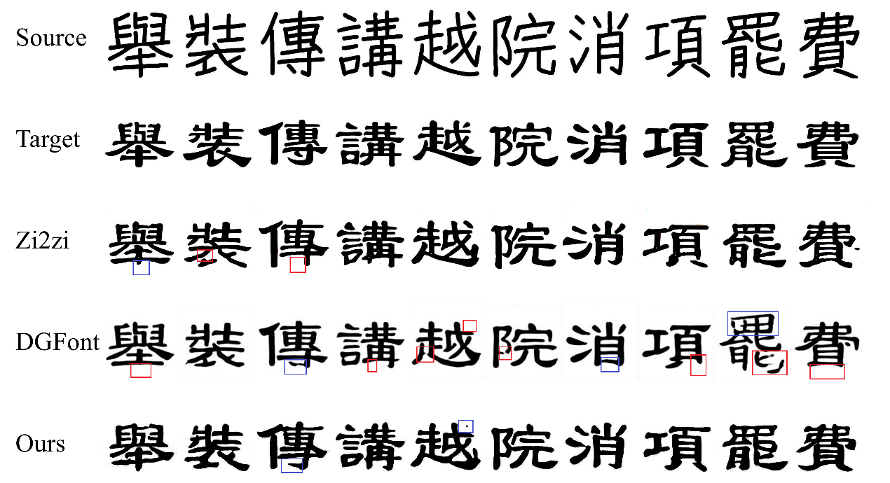
EXPERIMENTAL RESULTS

Slide 45
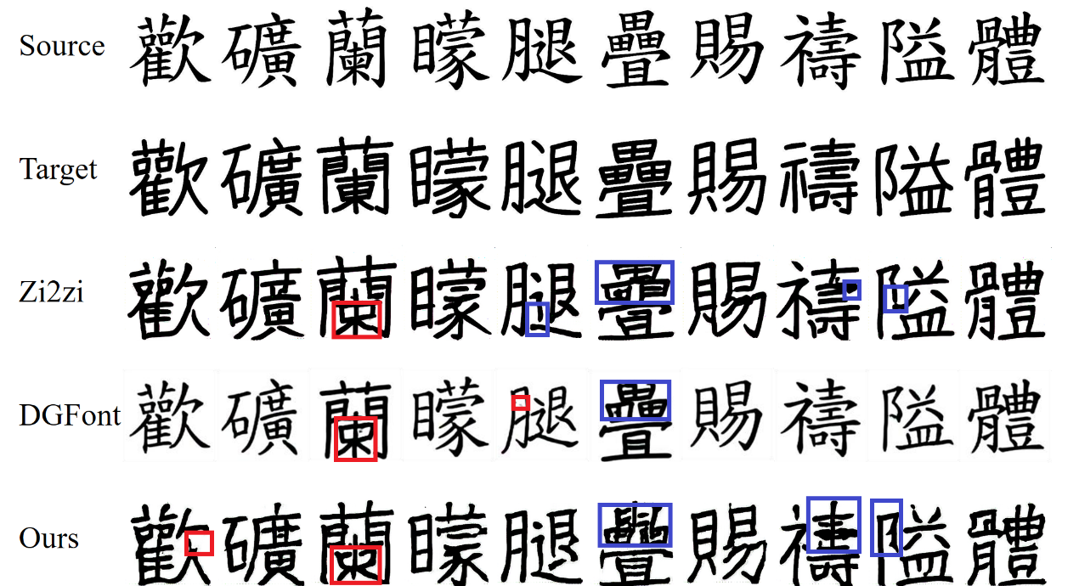
EXPERIMENTAL RESULTS
Failure generated results

Slide 46
EXPERIMENTAL RESULTS
Unseen handwriting style transfer
 | MSE↓ | SSIM↑ | PSNR↑ | LPIPS↓
zi2zi | 8247.936 | 0.705348 | 9.006736 | 0.167393
DGFont | 7973.457 | 0.597642 | 9.206459 | 0.133215
Ours | 7817.69 | 0.719561 | 9.347412 | 0.132056

Slide 47
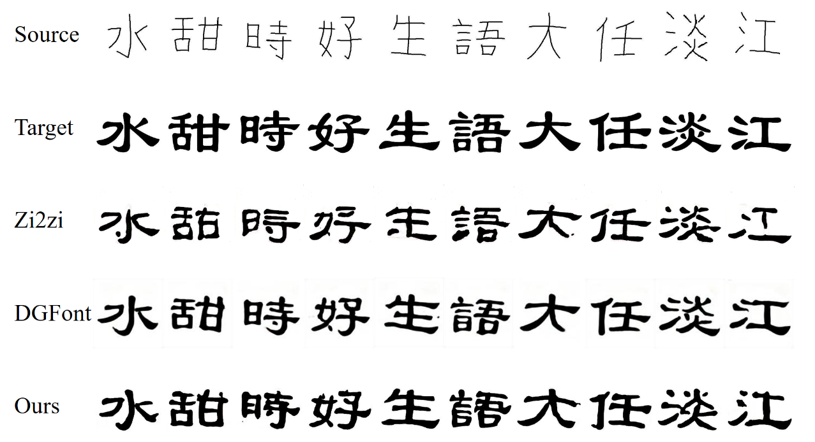
EXPERIMENTAL RESULTS

Slide 48
EXPERIMENTAL RESULTS
Increasing the character number of our dataset to 8,000 characters.
Compare adding skeleton images in training dataset or not.
 | MSE↓ | SSIM↑ | PSNR↑ | LPIPS↓
w/o skel | 9917.991 | 0.683681 | 8.223188 | 0.231439
with skel | 9885.835 | 0.693721 | 8.256562 | 0.204051

Slide 49
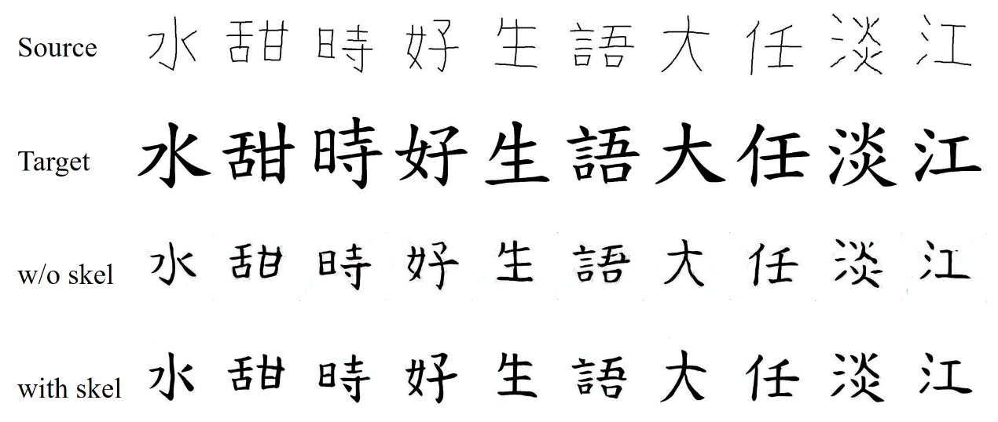
EXPERIMENTAL RESULTS

Slide 50
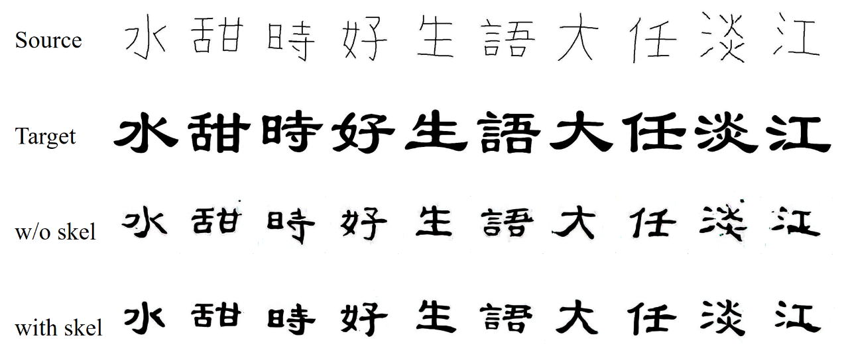
EXPERIMENTAL RESULTS

Slide 51
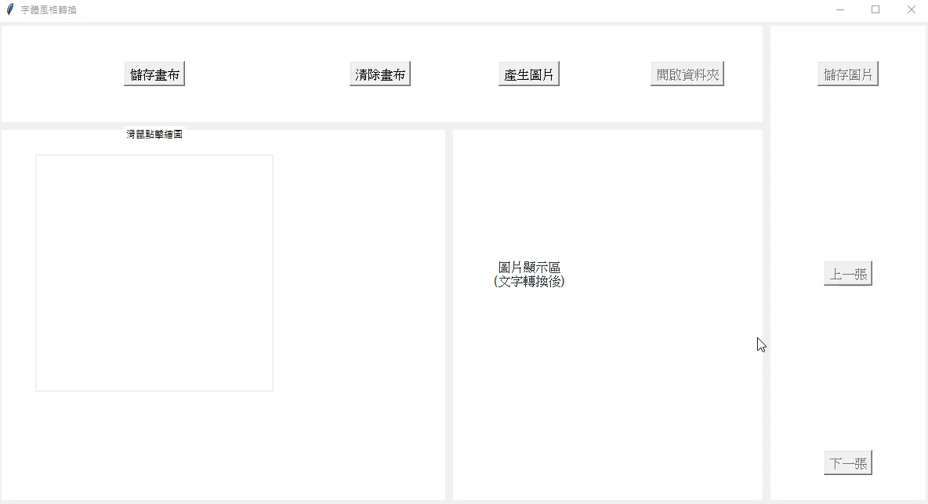
EXPERIMENTAL RESULTS

Slide 52
CONCLUSIONS
In this thesis, we propose a novel method for font generation.
To decrease the missing strokes in generated images, we embed style labels and use the skeleton feature in our model. The style label enables the model to generate the desired style.
The style label enables the model to generate the desired style.
The skeleton feature is used in our model to improve the generated results.
Incorporating an attention mechanism into our model allows us to analyze the spatial relationship between the content image and skeleton image. With guidance from the skeleton feature, our model can accurately generate and stylize strokes.

Slide 53
CONCLUSIONS
In experiments, we show that generated results transfer from unseen handwriting which written by pen.
Our study demonstrates the successful generated results transfer from previously unseen handwriting which written with a pen. To achieve this, we augmented our training dataset by including skeleton character images and additional labels after expanding the character set. After retraining, the generated results are improved.
adding skeleton character images in training dataset can help us to gain better generated results.
For test dataset, MSE is 7568.374, SSIM is 0.698, PSNR is 13.583, and LPIPS is 0.146, which shows that our method can transfer characters into different style and achieves the state-of-the-art performance.
In the future, we will investigate how the extracted components of character help model to generate detail of stokes and try to incorporate the idea of style transfer into our model.

